Slide 1

Gmail File System
Presented By:
Raghavendra Talur
USN 4JC07CS082

Slide 2


Cloud is the Future

Slide 3
Cloud is the Future
Factors
Homogenization of Computing
Broadband access
Economies of Scale
Application Areas
Infrastructure as a Service
Virtualization
File sharing and collaboration
Email

Slide 4
“Ideas are easy, execution is difficult.”
Hack to Innovation
Giving the user access to features otherwise inaccessible to them
Several years ago, former Googler Paul Buchheit famously created Gmail in a few days.
Adopting a “hacking” way of thinking may actually yield prototypes that help you get to market quicker and learn how your customers use your products

Slide 5
Gmail FS
A Simple Hack
Uses Webmail Service by Google
Provides a File storing, sharing and collaboration
Based on the Concept of Virtualization
Originally developed by Richard Jones.

Slide 6
The Concept
It works by building a filesystem with the Filesystem in Userspace loadable kernel module, and manages communication with Gmail through a special purpose Python library called libgmail. The actual GmailFS is also implemented in Python.
The speed of this filesystem is limited by the speed of the user's Internet connection, and the upload/download speed of the Gmail server. Files can be any size, and are stored as (segmented) attachments.

Slide 7
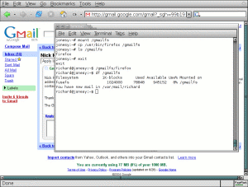
Picture Speaks a Thousand Words –
GmailFS

Slide 8
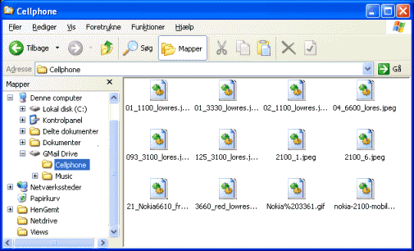
Picture Speaks a Thousand Words- Gmail Drive

Slide 9
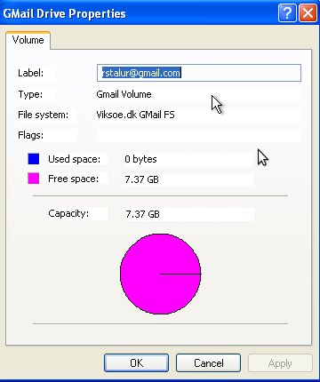
Properties

Slide 10
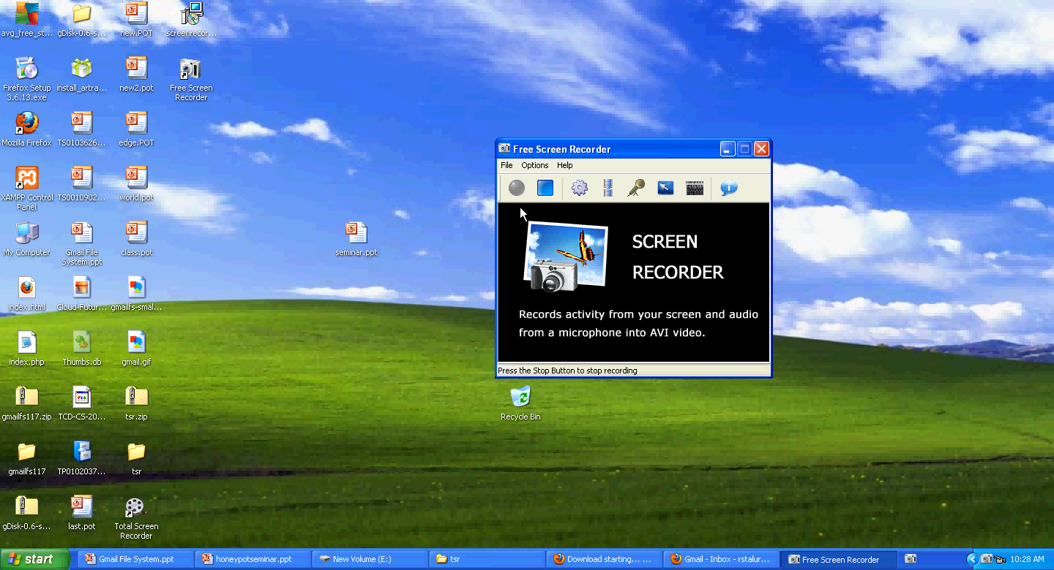
Video

Slide 11
Uses For An End User
A Simple Replacement for Pendrive
Collaboration over Network
A online Backup for your personal files

Slide 12
Modules, Dependencies and Implementation
Save a File /Send a mail – Uses IMAP or libgmail or smtp protocol
Get Directory Listing/ Use a file – IMAP or libgmail
FUSE
Gmail Account

Slide 13
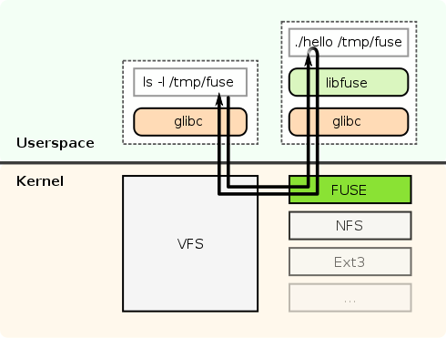
FUSE -- Filesystem in Userspace
Unlike traditional file systems that essentially save data to and retrieve data from disk, virtual filesystems do not actually store data themselves.

Slide 14
IMAP and SMTP
Internet message application protocol
Connected and disconnected modes of operation
Multiple clients simultaneously connected to the same mailbox
Server-side searches
Access to MIME message parts and partial fetch
Multiple mailboxes on the server
Server-side searches
IMAP4_SSL(“imap.gmail.com”,993)

Slide 15
IMAP and SMTP
Simple Mail Transfer Protocol
SMTP is a delivery protocol only.
Can send with attachments.
Very Simple when compared to IMAP and POP3
smtplib.SMTP(“smtp.gmail.com”,587)

Slide 16
Gmail Drive Implementation -Windows
Retains the idea of sending and accessing mails the same.
But FUSE is not available for Windows and alternatives are not good enough.
Hence the filesystem view is provided using a Windows Concept called Name Space Shell Extension
Eg Recycle Bin
It just another folder but with Properties as visible to the user different.

Slide 17
Gmailfs VS Gmail Drive
Gmailfs provides a true integration as a filesystem.Once mounted, any operation can be performed on it. Gmaildrive doesnot provide a Drive letter, so it cannot be used in scripts.
Gmailfs is not easy to use as it requires the user to manually mount the file system.
Gmailfs provides no GUI support.
Gmail Drive provides a simple installation and configuration.

Slide 18
My Implementation
Implemented for Linux.
Uses smtp to send mails.
Uses IMAP to list the directory.
Provides a minimalist GUI using shell scripting and Zenity.
Fetch and Delete feature of FUSE not implemented yet. Has to be done only through the gmail web interface.

Slide 19
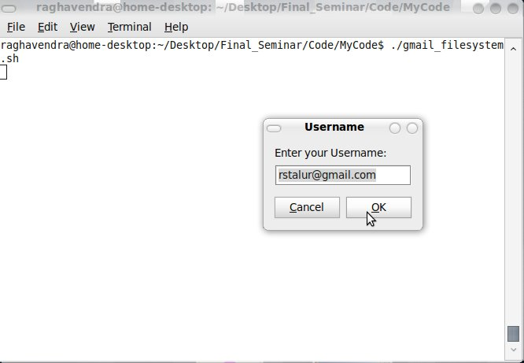
Screenshots

Slide 20
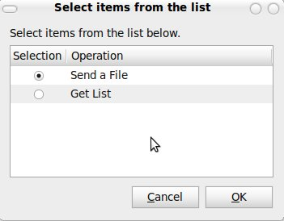
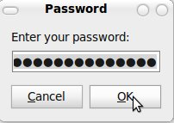
Screenshots

Slide 21
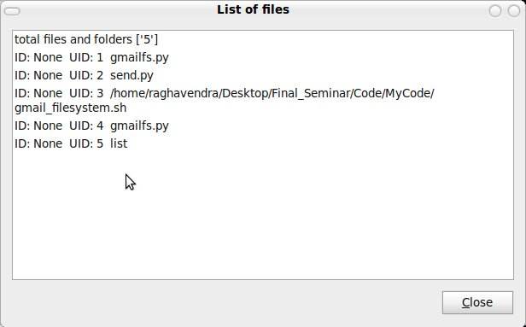
Screenshots

Slide 22
Significance other than a simple End User Program
It serves as a proof of concept in two areas
Cloud Computing
and
Virtual File Systems.
Cloud services are coming up which provide free Storage space which can be directly integrated into the User File system offering a perfect sync and backup.
Eg: Ubuntu Cloud: Ubuntu One
Rumors say Google will start its services too.

Slide 23
Significance Other Than A Simple End User Program
WikipediaFS : View and edit Wikipedia articles as if they were real files
s3fs-FuseOverAmazonS3: A FUSE-based file system backed by Amazon S3. Mount a bucket as a local file system read/write. Store files/folders natively and transparently on AWS: Simple Storage Service.
fuse-zip: Allows to use zip files as a filesystem (supports writing)
Can be extended in innovative ways to view tweets as files etc.

Slide 24
References
http://richard.jones.name/google-hacks/gmail-filesystem/gmail-filesystem.html
http://www.viksoe.dk/code/gmail.htm
http://www.python.org/
http://sr71.net/projects/gmailfs/
http://fuse.sourceforge.net/

